Slide 2
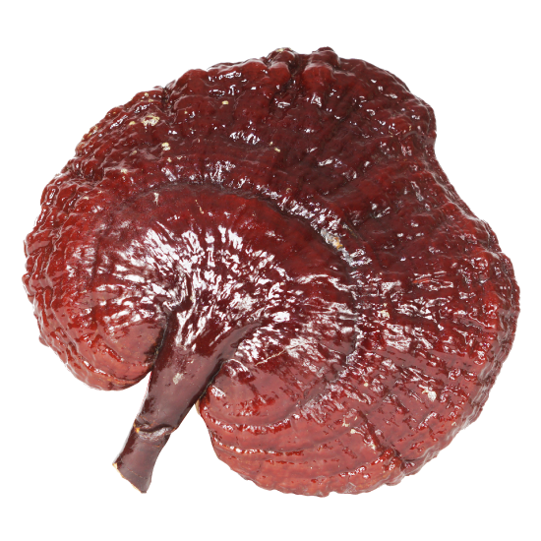
Ganotherapy

Slide 3
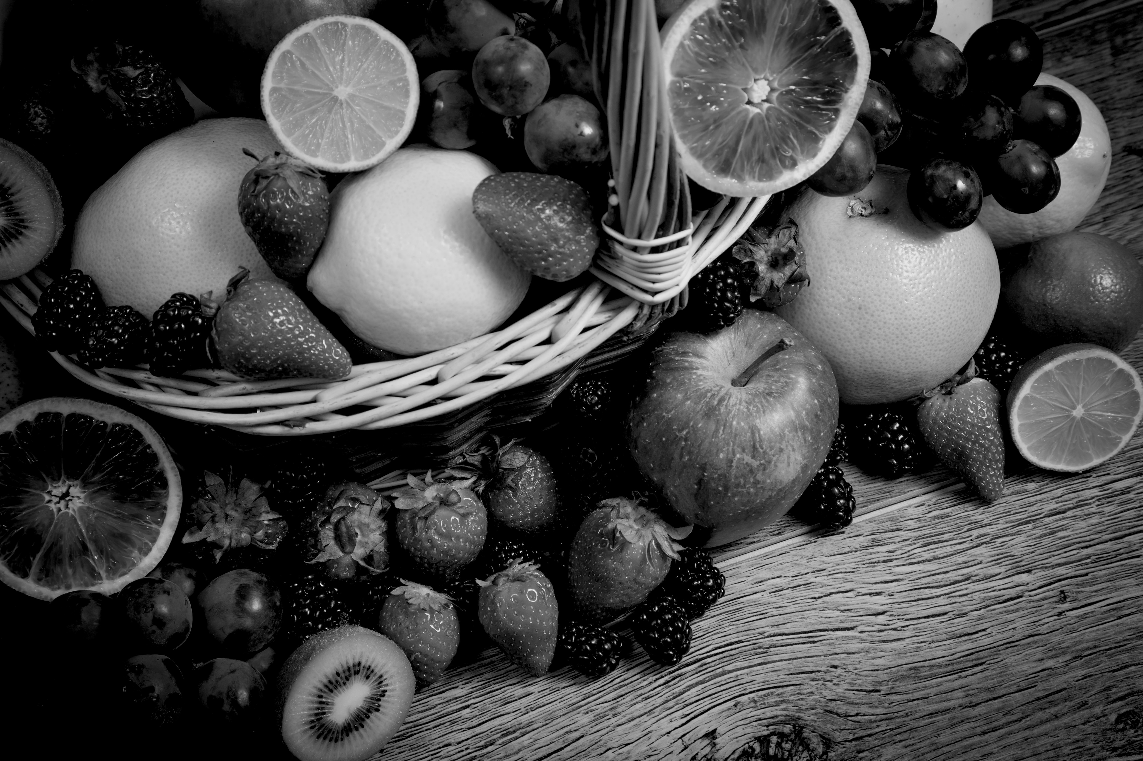
v
DIFFERENCE
NATURAL
FOOD
CONVENTIONAL
MEDICINE
TWO
APPROACHES
ON HEALTH
APPROACH
Holistic
Segmental
FOCUS
Health
Disease
METHOD
Prevention
Cure
PRODUCTS
Supplements
Drugs
GOAL
Wellness
Correction
Ganotherapy

Slide 4
v
FOUR PILLARS TO HEALTH
Positive Mental Attitude
Healthy Lifestyle
Healthy Diet
Supplementation
Ganotherapy

Slide 5
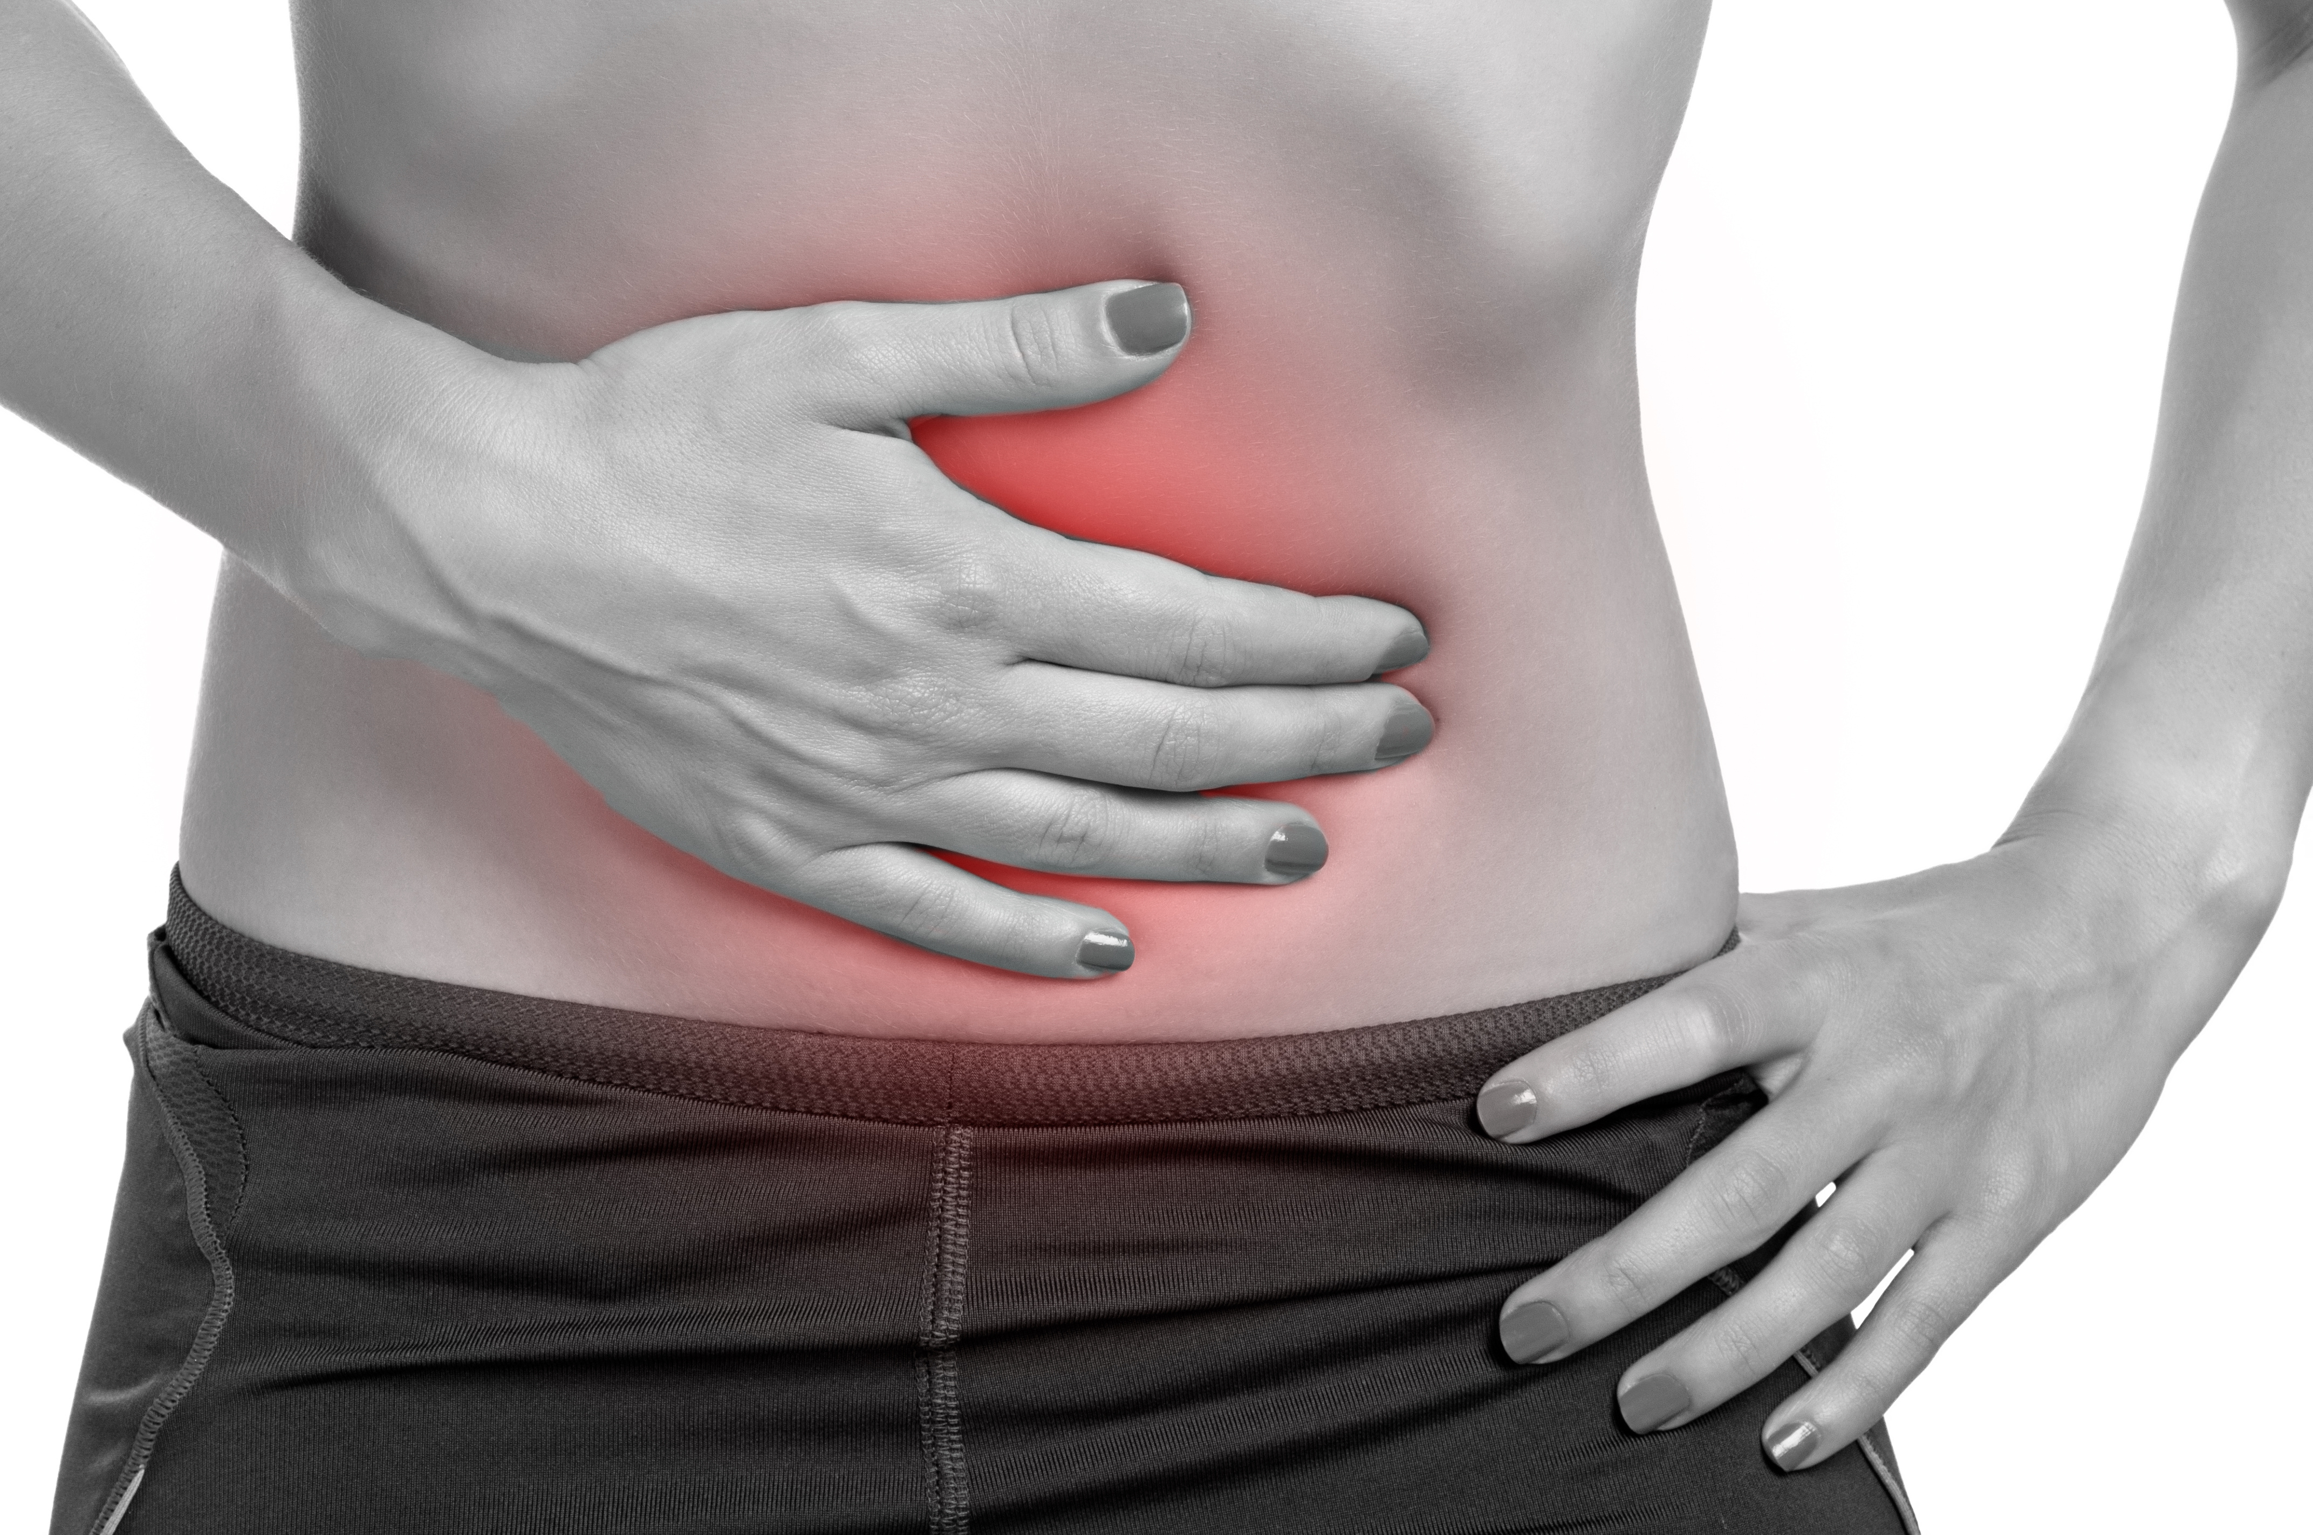
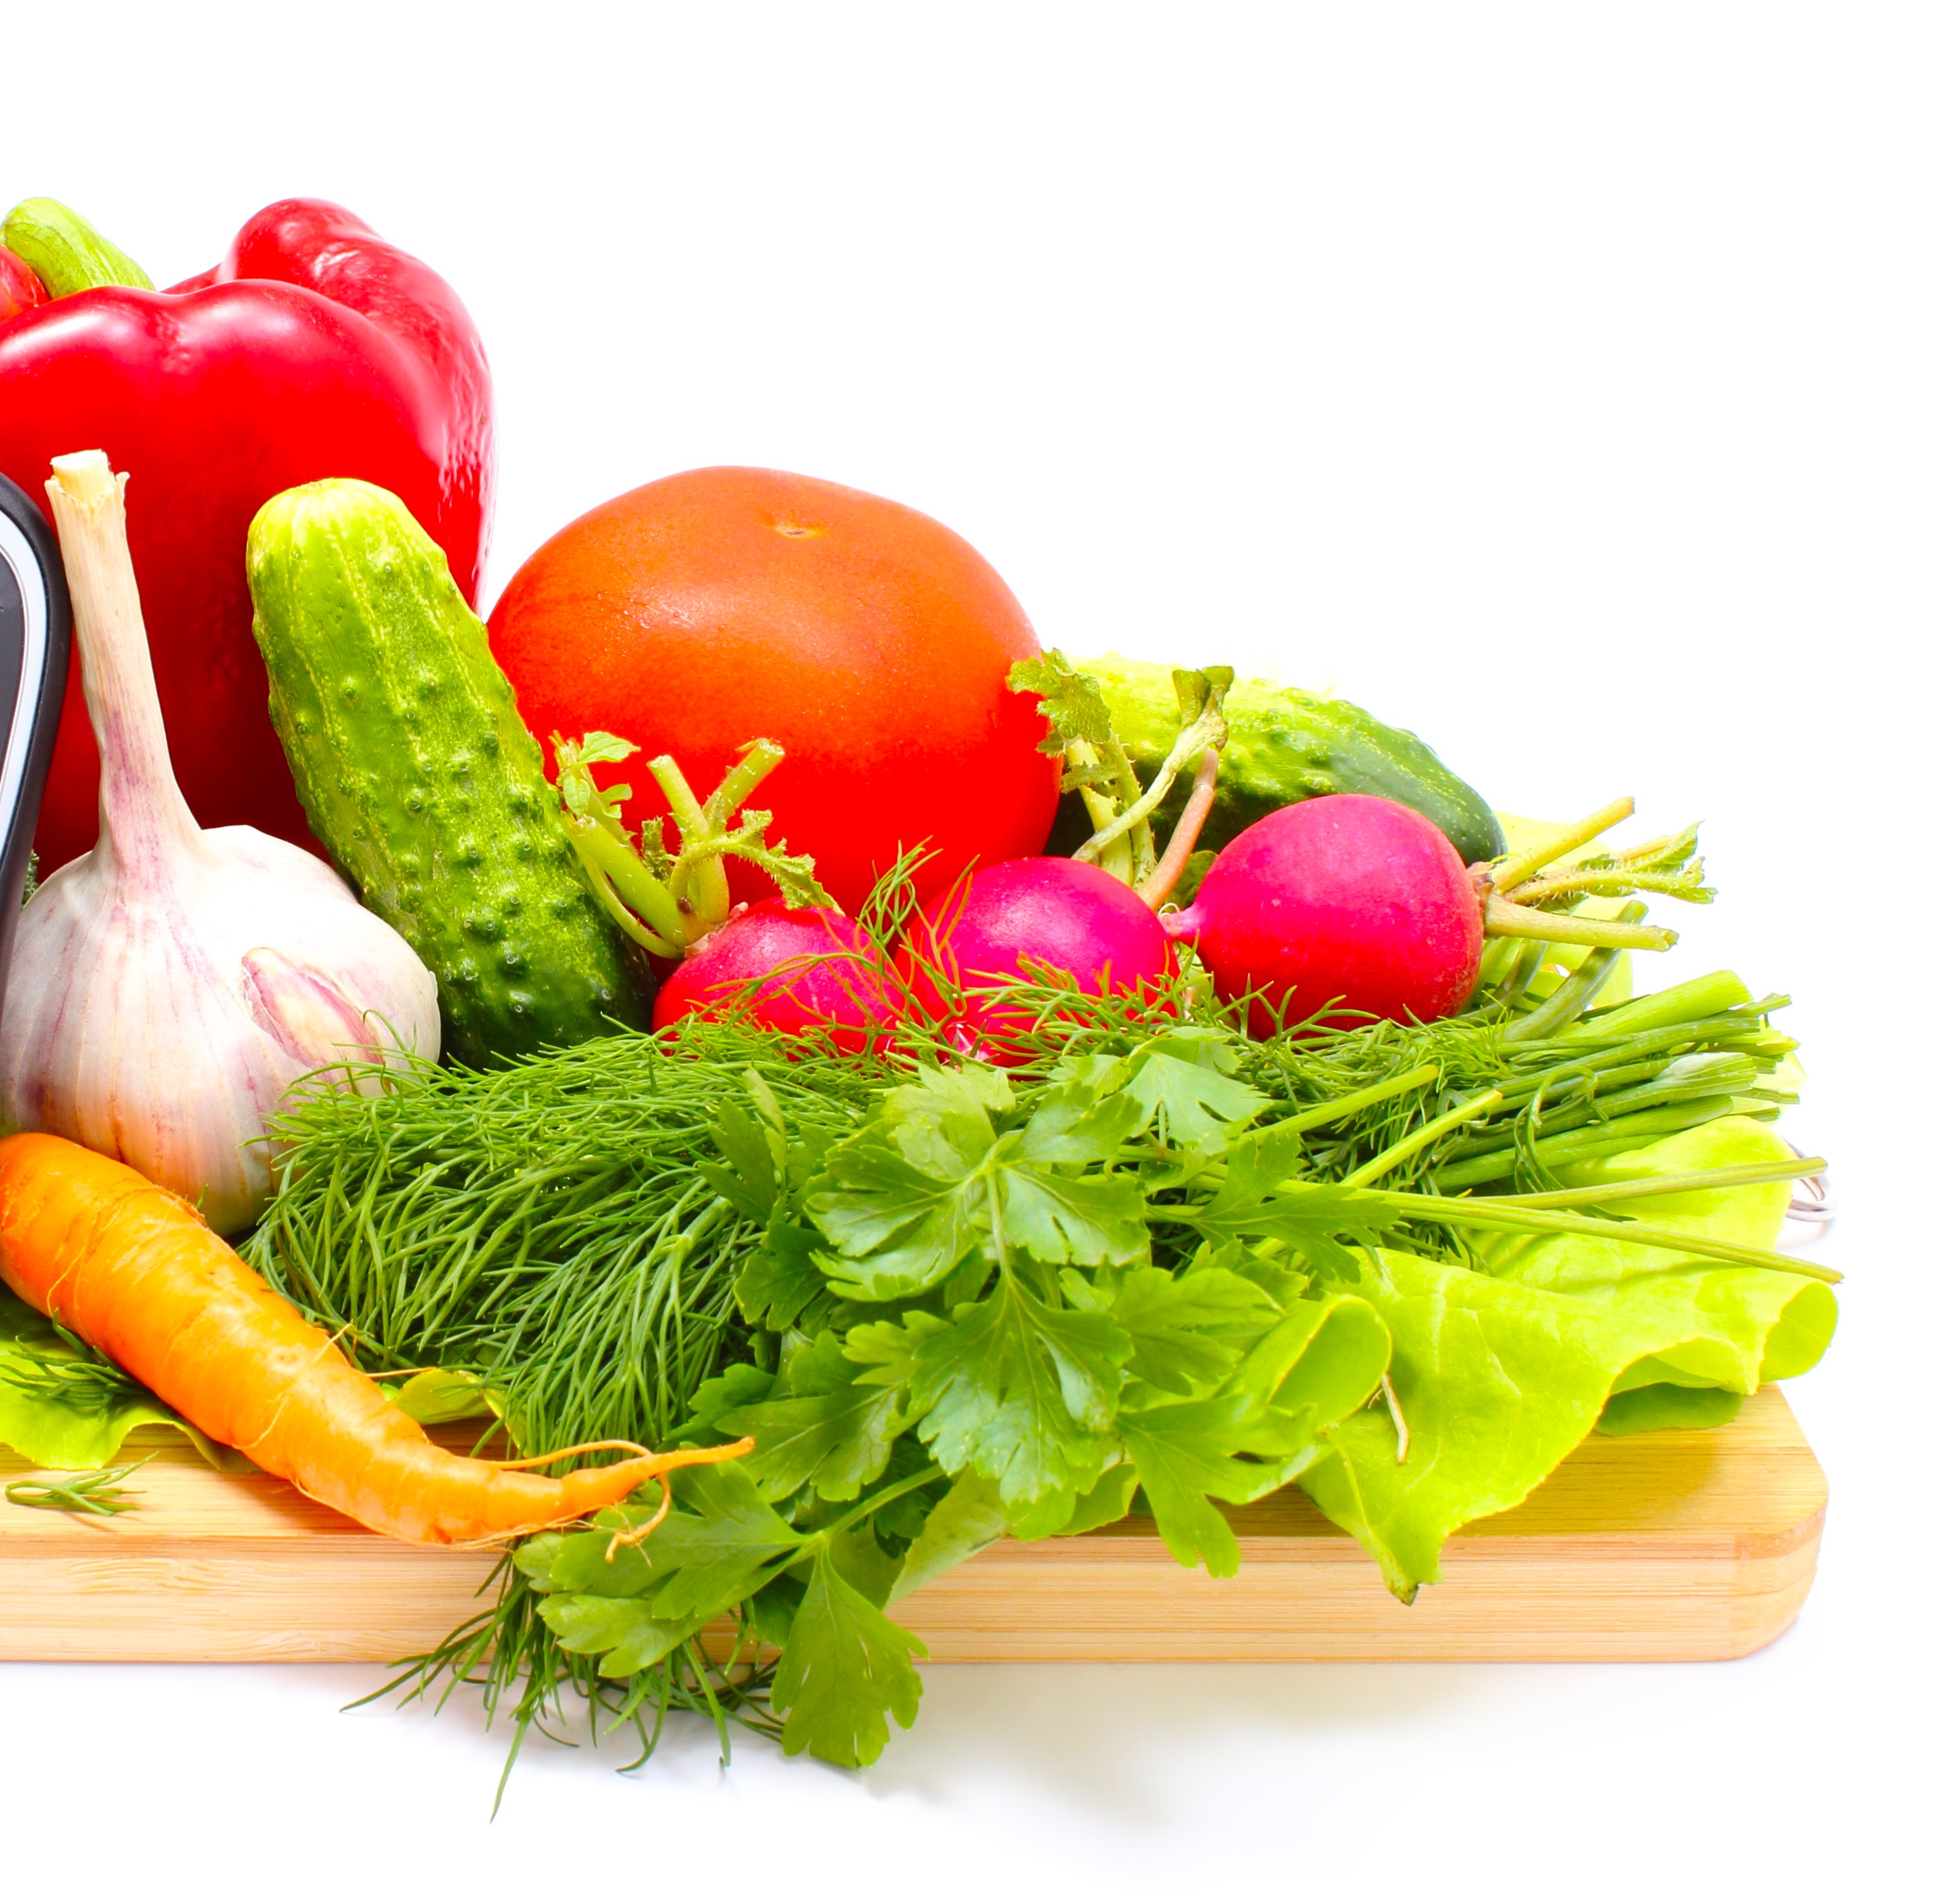
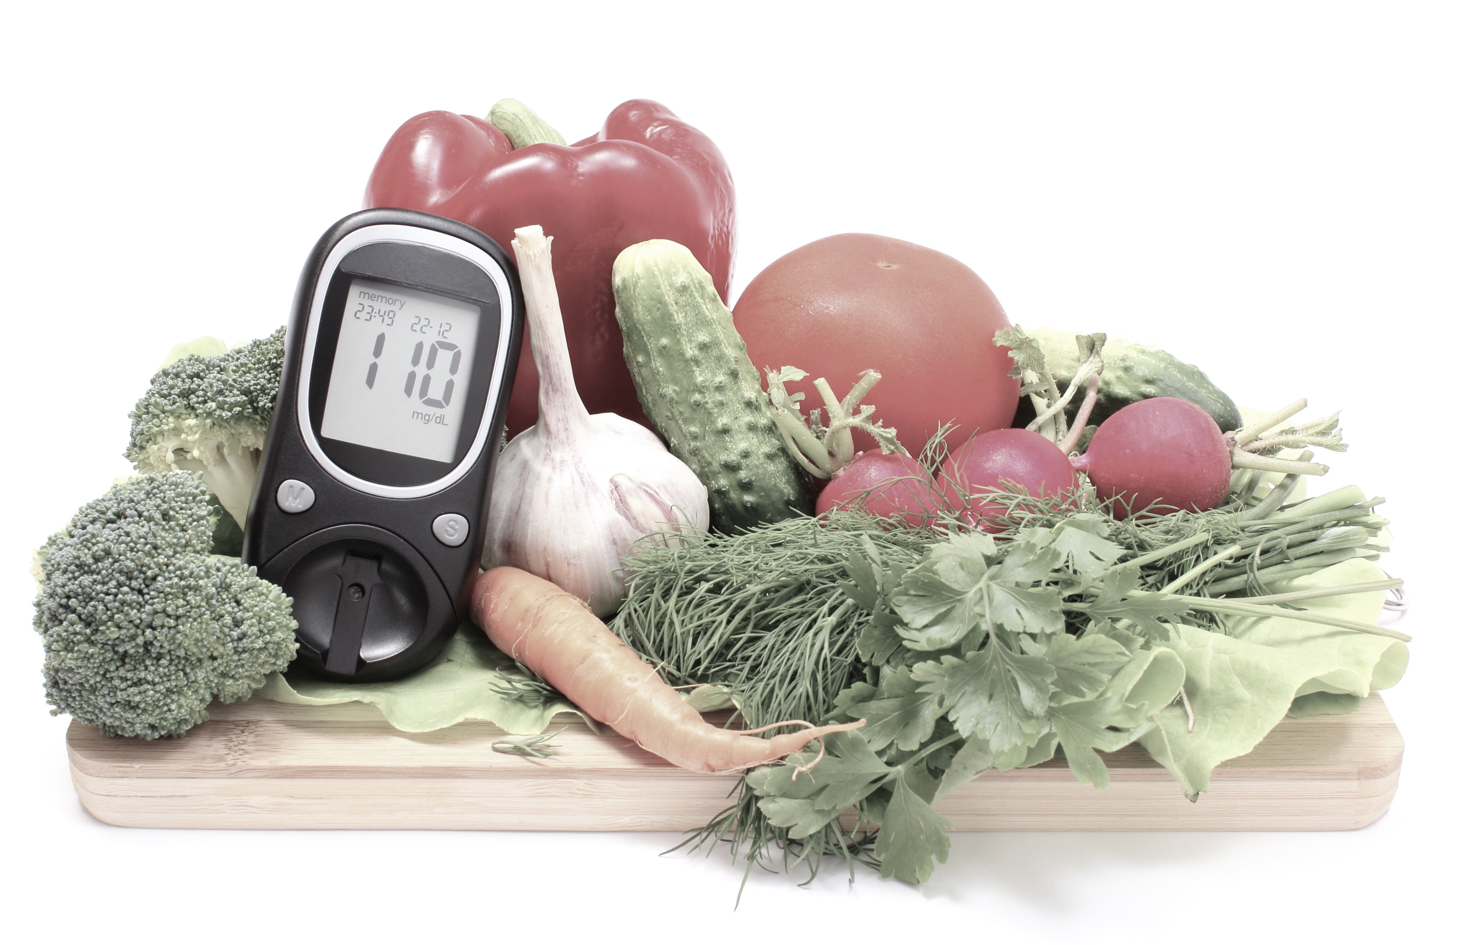
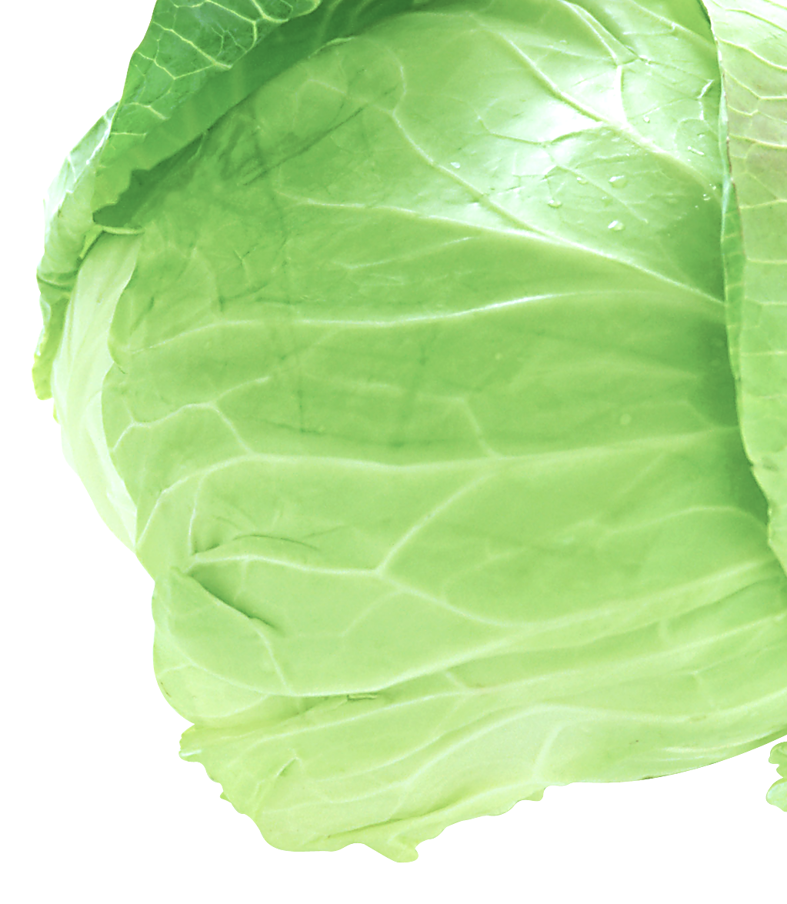
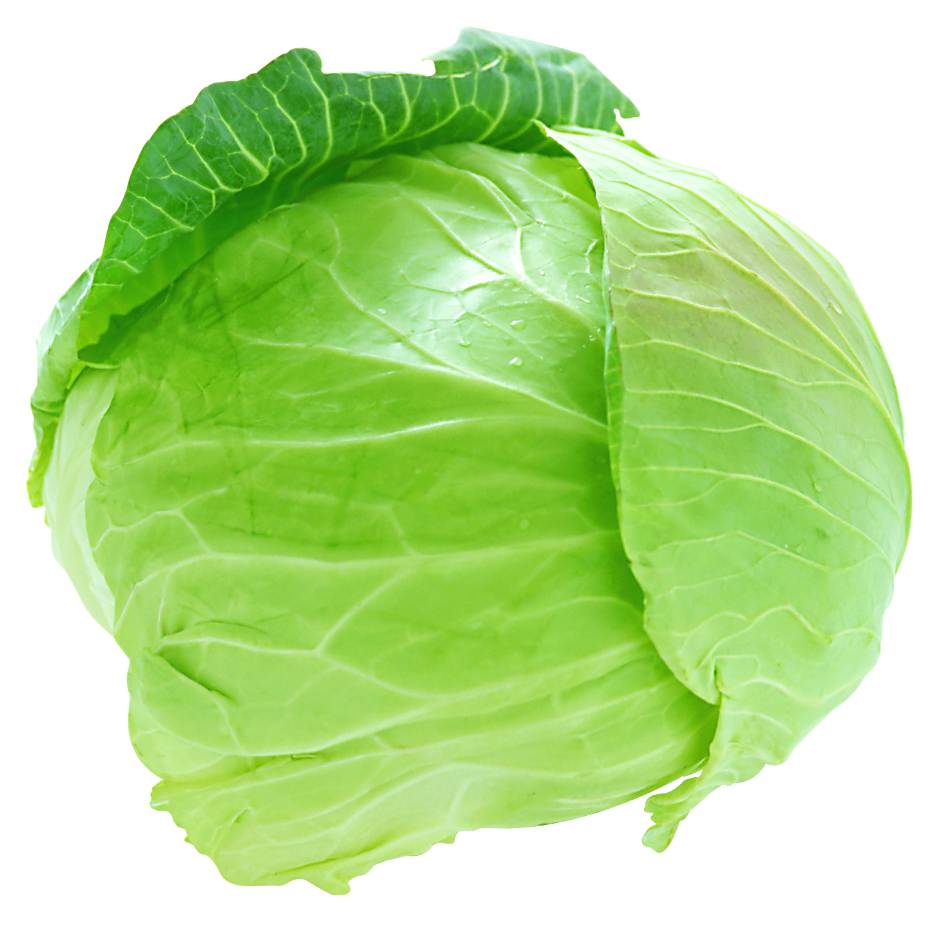
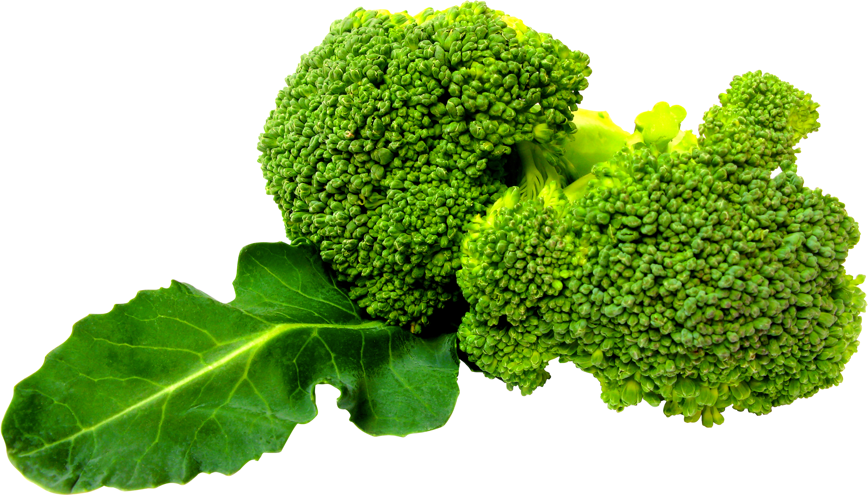
TOXIN AND IMBALANCE
Toxin and imbalance of body are caused by internal and external factors, such as: stress, modern lifestyle, free radicals, air pollution, polluted water, chemicals, drugs, etc.
The Eating Habit
Eat too much - Eat too often - Eat too fast
Eat too much acidic food
Eat too much cooked food
Eat too little green veggies
Ganotherapy

Slide 6
BODY AS THE BEST DOCTOR
3 Defense Levels of the Body to Deal with Toxin
1st Level of Defense
Discharge Phase
2nd Level of Defense
“Put Aside” Phase
3rd Level of Defense
Tumor Developing Phase
Ganotherapy

Slide 7
1ST LEVEL OF DEFENSE
The Discharge Phase
Toxins will be discharged from the body as:
Sweat
Urine
Phlegm
Stools
Ganotherapy

Slide 8
2ND LEVEL OF DEFENSE
The “Put Aside” Phase
Toxin will be crystallized or combined with inert materials
Crystallized into Uric Acid and Stone
Combined with inert materials to form cholesterol and fat
Ganotherapy

Slide 9
3RD LEVEL OF DEFENSE
Tumor Developing Phase
Toxins that cannot be discharged from the body after a long period of time will develop into health problems such as tumor.
Ganotherapy

Slide 10
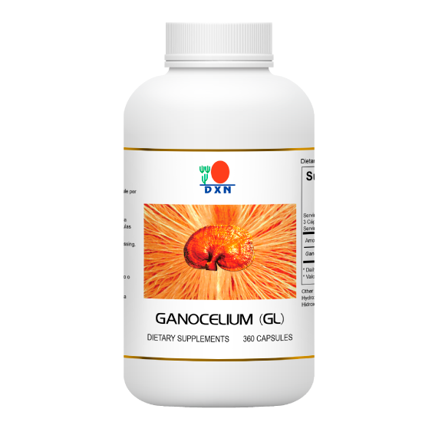
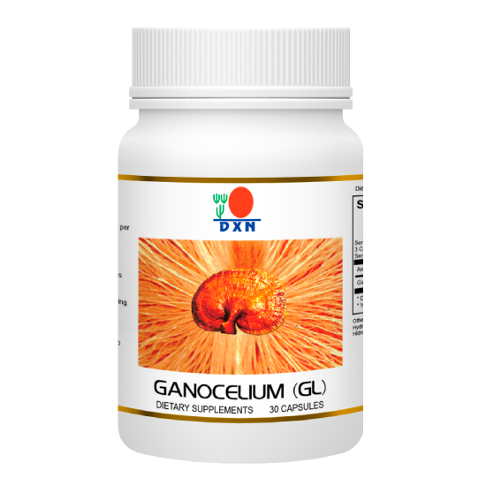
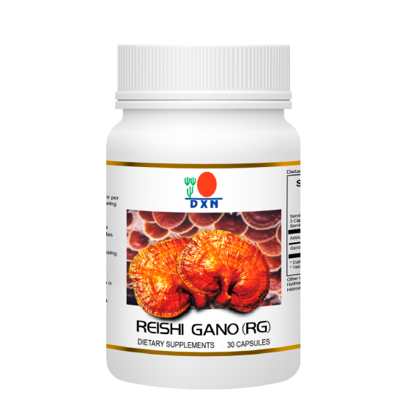
GANODERMA SUPPORTS THE BODY
RG supports the body in detoxification
GL supports the body In balancing
Ganotherapy
Food and dietary supplement products sold by Daxen are intended to contribute to the daily diet and overall health and are not intended for use in the prevention, treatment, mitigation, or cure of any disease or health related condition. Consult an appropriately licensed health care practitioner for a medical history evaluation, diagnosis, treatment, and health recommendations.

Slide 11
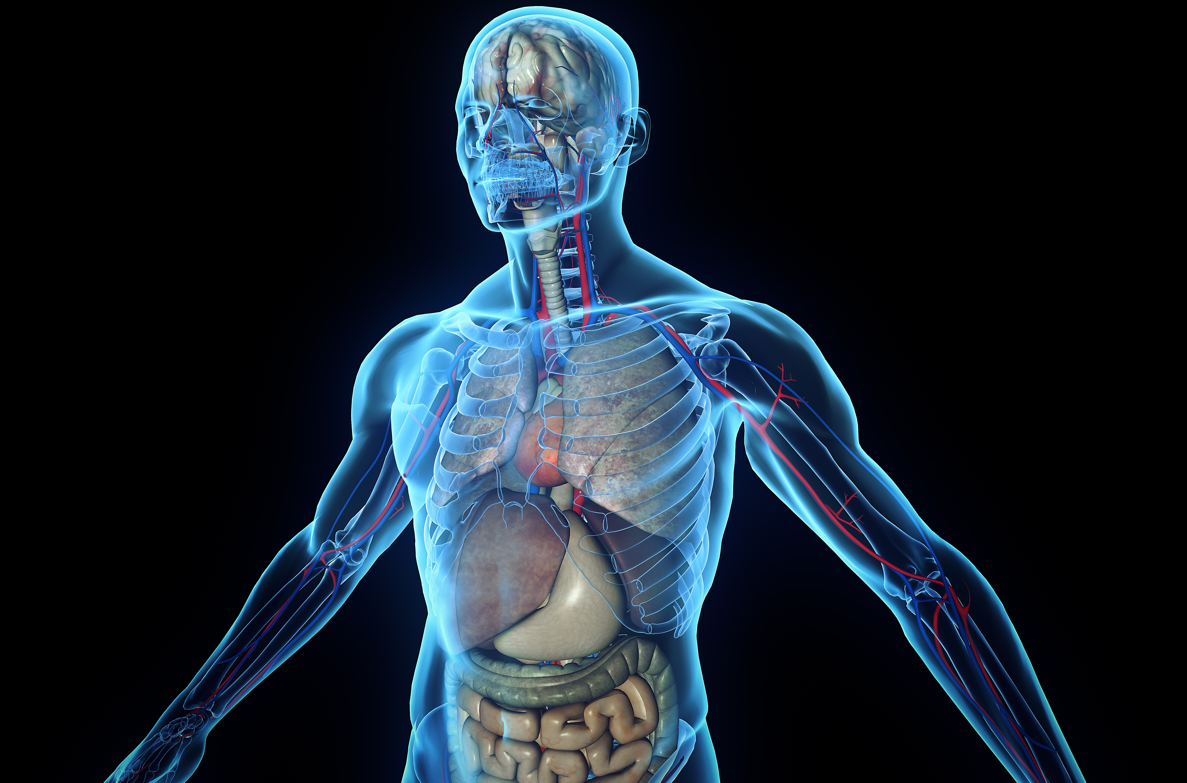
1ST OBSERVATION THEORY
All health problems of the human body arise from 2 main causes:
Toxin
Imbalance of body system
Ganotherapy

Slide 12
2ND OBSERVATION THEORY
Ganoderma supports the body,
The body takes care of its own health problems
The “ABC rule”
Ganotherapy
Food and dietary supplement products sold by Daxen are intended to contribute to the daily diet and overall health and are not intended for use in the prevention, treatment, mitigation, or cure of any disease or health related condition. Consult an appropriately licensed health care practitioner for a medical history evaluation, diagnosis, treatment, and health recommendations.

Slide 13
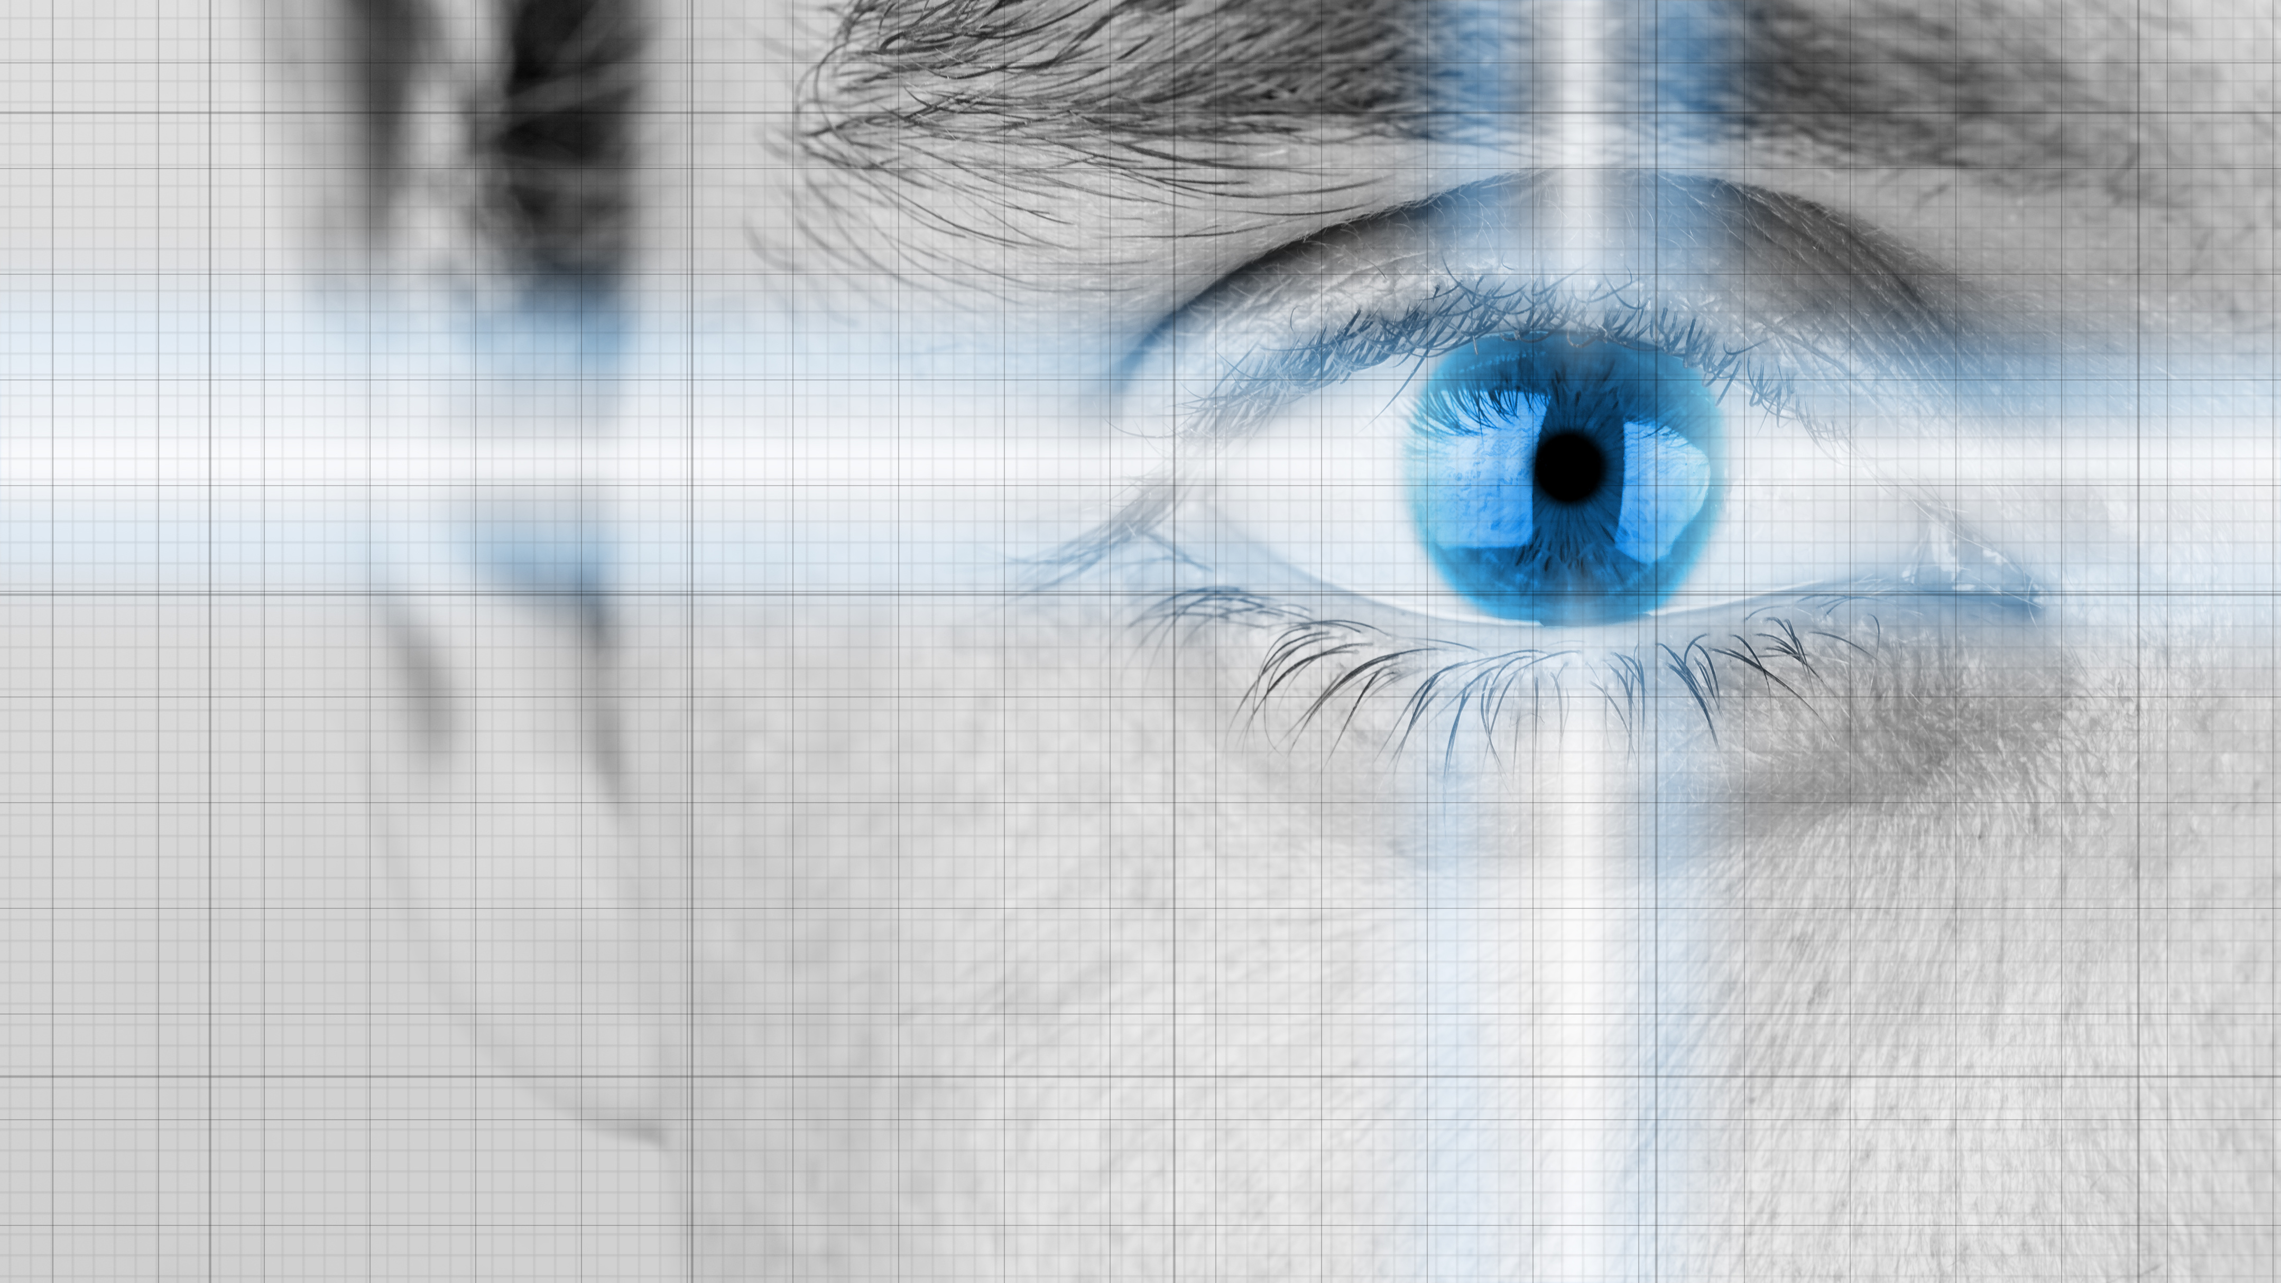
THE 3RD OBSERVATION THEORY
Reaction is caused by the body, not ganoderma
It has been observed that Ganoderma works on the human body with or without awareness.
Reflexology
Emotional
Physical
Ailment Reflection
Ganotherapy

Slide 14
THE 4TH OBSERVATION THEORY
Dosage is independent of situation
1, 2, 4, 6 way of consumption
For General Health Maintenance
1st week – 1 pair / day
2nd week – 2 pairs / day
3rd week – 4 pairs / day
4th week – 6 pairs / day
No response – Increase dosage gradually
Manageable Situation - Continue dosage
Not Manageable Situation – Reduce dosage by half
The Time factor is more important than the Dosage
Ganotherapy

Slide 15
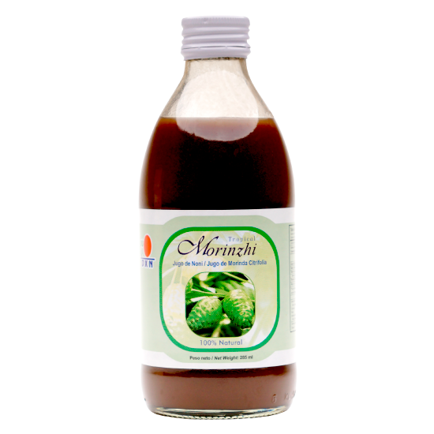
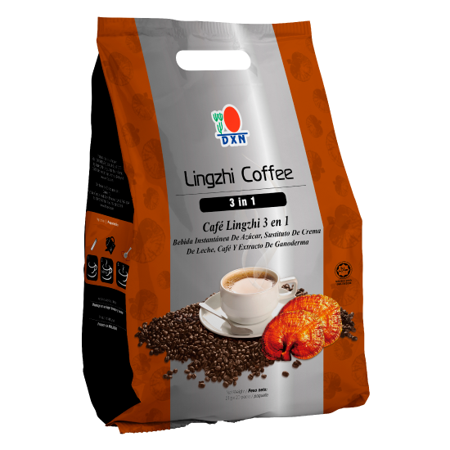
ACIDIC vs ALKALINE
Human body needs to eat alkaline food and acidic food in the ratio of 4:1
Modern eating habits is just the reverse
Acidic foods:
Alkaline food:
Meat, Soft drinks, processed foods, sugar, Pork, Alcohol, Coffee & Black Tea, etc.
Sorghum, Millet, Wheat, Corn and Vegetables.
Consume DXN alkaline food like RG/GL, Spica Tea, Lingzhi Coffee, Spirulina & Morinzhi
Ganotherapy
Food and dietary supplement products sold by Daxen are intended to contribute to the daily diet and overall health and are not intended for use in the prevention, treatment, mitigation, or cure of any disease or health related condition. Consult an appropriately licensed health care practitioner for a medical history evaluation, diagnosis, treatment, and health recommendations.

Slide 16
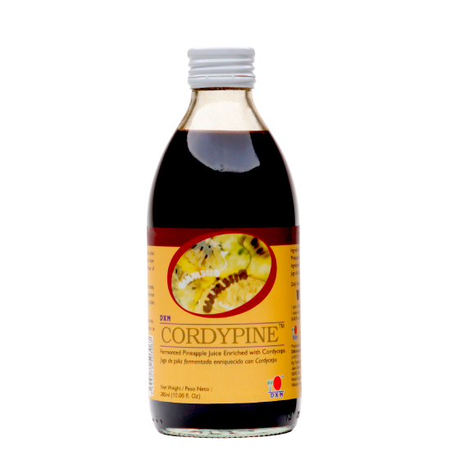
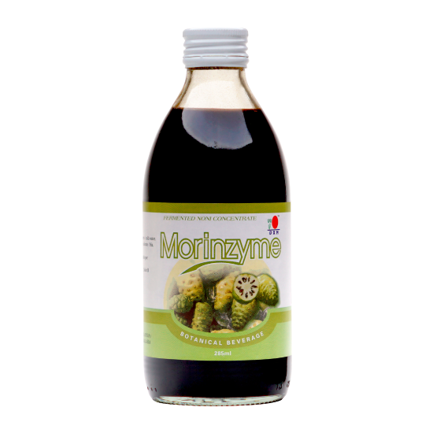
ENZYME THEORY
Diabetes is not the Problem; the Food is
Diabetes Problem
is caused by
Pancreas Problem
is caused by
Digestive Problem
is caused by
Food Problem
Consume:
RG/GL, Spirulina, Morinzyme and Cordypine
is caused by
Lack of Enzyme
Ganotherapy
Food and dietary supplement products sold by Daxen are intended to contribute to the daily diet and overall health and are not intended for use in the prevention, treatment, mitigation, or cure of any disease or health related condition. Consult an appropriately licensed health care practitioner for a medical history evaluation, diagnosis, treatment, and health recommendations.

Slide 17
GREEN THEORY
The Cycle of Red Blood Production
When red Blood Cell Dies
It is sent to
SPLEEN for decomposition
It is sent to
LIVER for further decomposition
It is sent to
KIDNEY which produces hormones
It is sent to
BONE MARROW to produce hemoglobin
It is sent to
Consume:
Spirulina.
RECYCLED RED BLOOD
Ganotherapy
Food and dietary supplement products sold by Daxen are intended to contribute to the daily diet and overall health and are not intended for use in the prevention, treatment, mitigation, or cure of any disease or health related condition. Consult an appropriately licensed health care practitioner for a medical history evaluation, diagnosis, treatment, and health recommendations.

Slide 18
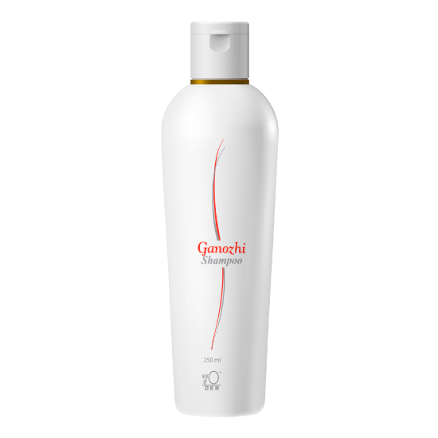
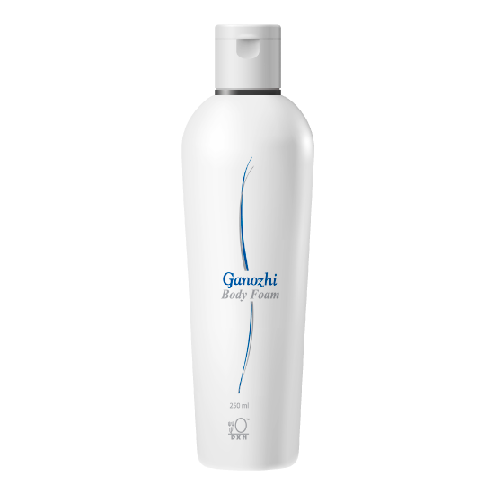
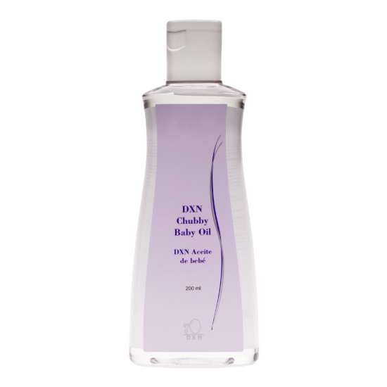
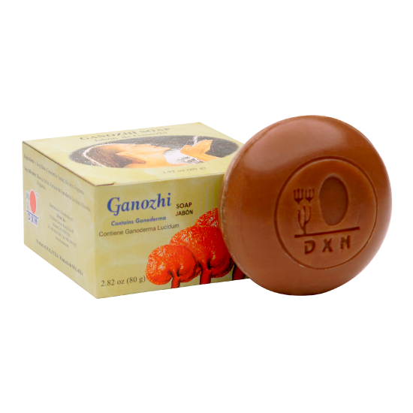
What is good For your stomach Is good for your face
Ganotherapy
Food and dietary supplement products sold by Daxen are intended to contribute to the daily diet and overall health and are not intended for use in the prevention, treatment, mitigation, or cure of any disease or health related condition. Consult an appropriately licensed health care practitioner for a medical history evaluation, diagnosis, treatment, and health recommendations.

Slide 19
7 GROUPS OF CONSUMERS
1. Pregnant woman
2. Infant
3. School children/ students
4. Teenagers
5. Married couples
6. Seniors
7. Sick people
Ganotherapy
Food and dietary supplement products sold by Daxen are intended to contribute to the daily diet and overall health and are not intended for use in the prevention, treatment, mitigation, or cure of any disease or health related condition. Consult an appropriately licensed health care practitioner for a medical history evaluation, diagnosis, treatment, and health recommendations.

Slide 20
Ganotherapy
THANK YOU

Slide 21
Ganotherapy
THANK YOU

